Slide 1
CAN Interface
Version 1.1
Wang Hyunho
2021-07-15

Slide 2
Date | Version | Description
2021-06-30 | 1.0 | Released.
2021-07-15 | 1.1 | STM32F429II Clock: Internal 144MHz -> External 180MHz STM32F429II CAN baud rate: 500Kbps -> 400Kbps STM32F103RE Clock: Internal 8MHz -> Internal 60MHz STM32F103RE CAN baud rate: 500Kbps -> 400Kbps

Slide 3
CAN Interface
요약
Step motor 구동을 위한 Control Board와 Driver Board 간 Can Interface 구현
진행 내용
Control Board, Driver Board 각각 Can Interface 구현 및 테스트
Control Board와 Driver Board를 1:N 연결 테스트 진행
신호 감쇄 확인 및 보드 수정 (33옴->0옴), 수정 완료
송수신 테스트 완료
H/W 및 CAN 구성
Control Board
Driver Board
Driver Board
Driver Board
 | Control Board | Driver Board
MCU Part Name | STM32F429II | STM32F103RE
MCU System Clock | 180MHz (External) | 60MHz (Internal)
Used CAN | CAN2 | CAN1
CAN Mode | Slave Mode | Master Mode
Baud rate | 400Kbps | 400Kbps

Slide 4
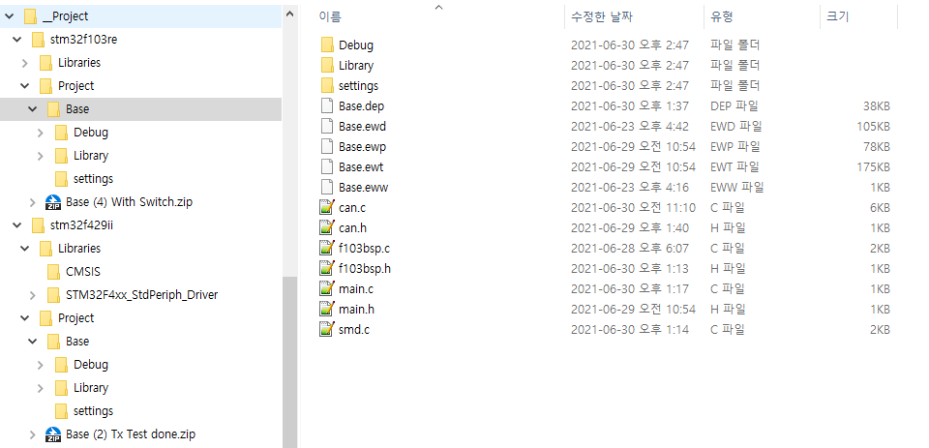
CAN Interface
Project 구성
Driver board
Backup file
User files
Control board
Backup file

Slide 5
CAN Interface
Major Functions
Group | Control Board | Driver Board | Type | Description | File
CAN | CAN* can; | CAN* can; | Extern pointer | can->xxx() | can.h, can.c
CAN | CanSetIntr0 CanResetIntr0 | CanSetIntr0 CanResetIntr0 | Function | Rx Interrupt Flag 설정 및 리셋 | can.h, can.c
CAN | CanInit() | CanInit() | Function | CAN Library 초기화 | can.h, can.c
CAN | CanConfig() | CanConfig() | Function | CAN alternate function 구성 | can.h, can.c
CAN | CanSend(…) | CanSend(…) | Function | CAN TX 전송 | can.h, can.c
BSP | UserClockSetting() | - | Function | STM32F429II의 PLL Clock 설정 144MHz | f429bsp.h, f429bsp.c
BSP | BspInit() | BspInit() | Function | Board support packet 초기화 | fxxxbsp.h, fxxxbsp.c
BSP | SetTimer0() ResetTimer0() | SetTimer0() ResetTimer0() | Function | Timer Interrupt Flag 설정 및 리셋 | fxxxbsp.h, fxxxbsp.c
BSP | LedInit() | LedInit() | Function | LED 초기화, Control 2개, Driver 1개 | fxxxbsp.h, smd.c
BSP | TimerInit() | TimerInit() | Function | 50ms interval timer interrupt 생성 | fxxxbsp.h, fxxxbsp.c

Slide 6
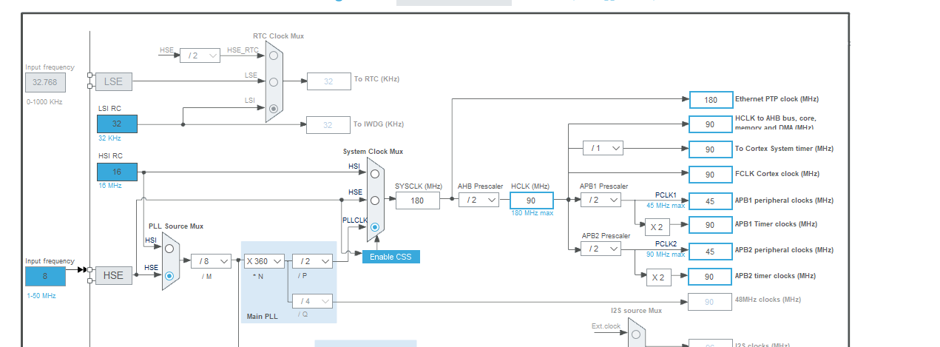
CAN Interface – STM32F429II (1)
Clock Configuration
1) HSE Enabled
2) PLL_M 8
3) PLL_P 2
4) SYS_CLK 180MHz
5) AHB Prescaler 2
6) HCLK 90MHz
7) APB1 Prescaler 2
8) PCLK1 peripheral clock : 45MHz
timer clock : 90MHz

Slide 7
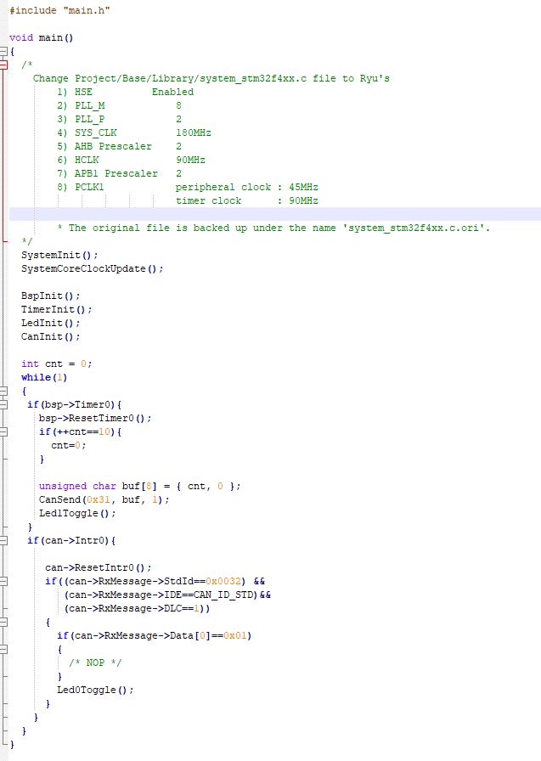
CAN Interface – STM32F429II (2)
Control Board 동작 설명
Clock 관련 파일 교체
(교체된 파일 설정 내용)
초기화
50ms 마다 전송
(송신 StdId = 0x31)
Timer Interrupt (50ms)
Can Rx Interrupt 처리
(수신 StdId = 0x32)

Slide 8
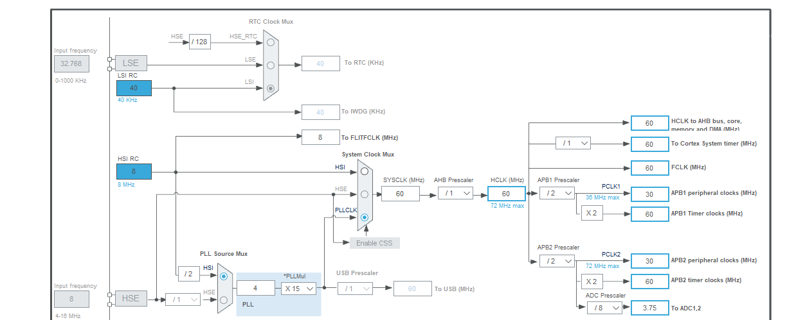
CAN Interface – STM32F103RE (1)
Clock Configuration
1) HSI Enabled
2) PLL 4
2) PLL MUL 15
4) SYS_CLK 60MHz
5) AHB Prescaler 1
6) HCLK 60MHz
7) APB1 Prescaler 2
8) PCLK1 peripheral clock : 30MHz
timer clock : 60MHz

Slide 9
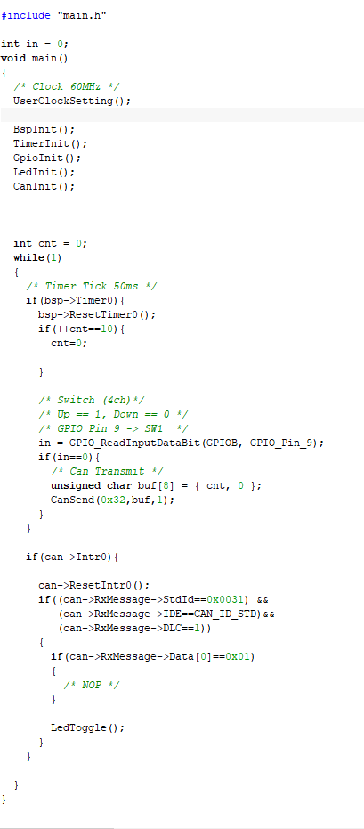
CAN Interface – STM32F103RE (2)
Driver Board 동작 설명
추가 함수
초기화
Timer Interrupt (50ms)
SW 1 확인
후, TX 전송
(송신 StdId = 0x32)
Can Rx Interrupt 처리
(수신 StdId = 0x31)

